Slide 1
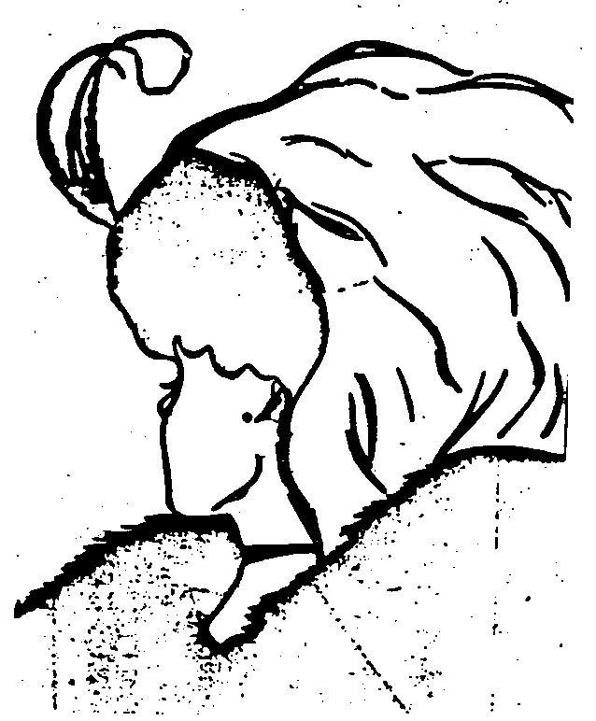
Chapter 3
Perceiving
Others

Slide 2
Week 4 goals
Read chapter 3 of textbook
Understand perception as a process
Examine our influences on perception
Learn how we interpret information
Learn how we form impressions of others
Learn perception checking process
Complete Participation 3

Slide 3
On the next screen there is a picture:
Write down as many different things you see that compose the picture?
How did you notice?
How does this connect to perceptions?

Slide 4
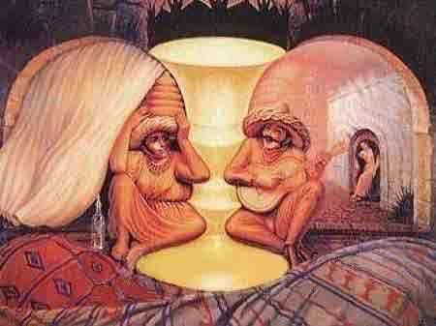
Add pictures

Slide 5
Perception process
Selecting
  Awareness test
Did you pass the awareness test? Why or why not?
Organizing
Interpreting
External-Response/negotiation
Notes:
Example to go through perception process
Boys will be girls
https://www.youtube.com/watch?v=FukzyfIqYf8
Culture and gender in group out group, social and gender roles
Be competent, Never make assumptions
1st order reality
2nd order reality
Shared reality

Slide 6
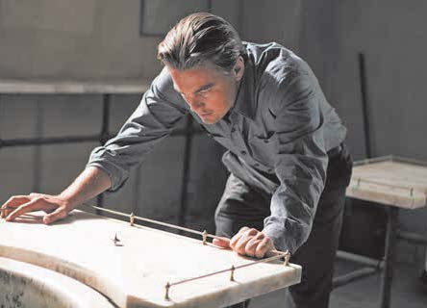
Perception as a Process
Perception is the process of selecting, organizing, and interpreting information from our senses.
Stephen Vaughan/© Warner Bros./Everett Collection

Slide 7
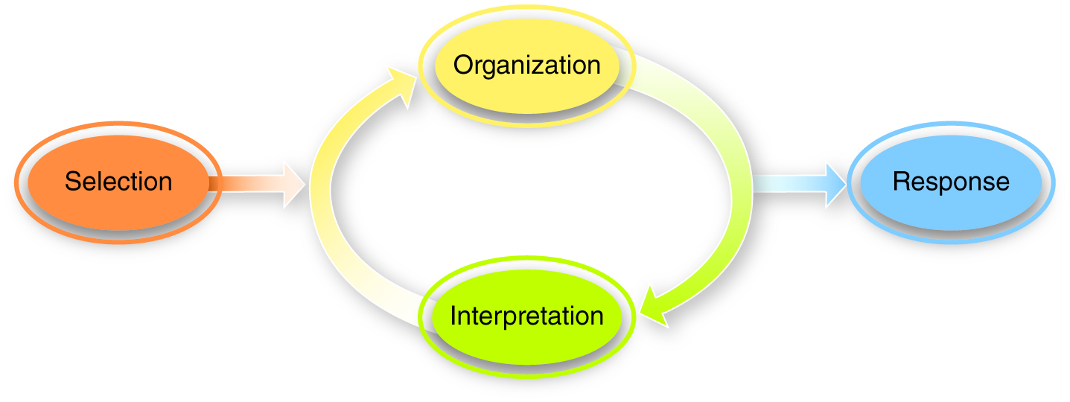
The Process of Perception
Figure 3.1

Slide 8
Influences on perceptions
Culture
Gender
Psychological
  Personality
Physiological
Notes:
Example to go through perception process
Boys will be girls
https://www.youtube.com/watch?v=FukzyfIqYf8
Culture and gender in group out group, social and gender roles
Be competent, Never make assumptions
1st order reality
2nd order reality
Shared reality

Slide 9
Influences on perceptions
Gender and culture
Boys will be girls
How did gender and culture influence your perception of video?

Slide 10
Interpreting the Information
Attributions are explanations for others’ comments or behaviors.
Attributions take two forms:
• Internal
• External

Slide 11
Internal Attributions
Internal (dispositional): behavior stems from internal causes, namely personality
Driving
  That lady is an idiot!
  No Reply to Email
  Prof doesn’t care

Slide 12
External Attributions
External (situational): behavior stems from external causes, namely circumstance
  Bad Driver
    First time driving-learning
  No Reply to Email
    Had to take dog to vet

Slide 13
Interpreting the Information (cont.)
Three errors in attribution:
1. Fundamental attribution error
2. Actor-observer effect
3. Self-serving bias

Slide 14
Fundamental Attribution Error
Make internal attributions about other
  Don’t/can’t perceive whole situation
  Don’t/can’t know the external circumstances
  Supplemental video to add to explanation

Slide 15
Actor-Observer Effect
Make external attributions about own behaviors
Give credit to external factors for our cx
Conflict- our angry response is a result of their comments

Slide 16
Self-Serving Bias
Make internal attributions regarding our successes, and external attributes regarding our failures
  I passed the exam!
    ______ attribution
  I failed the exam ☹
    ______ attribution

Slide 17
Impressions: Constructing Gestalts
Gestalts are general impressions of people, either positive or negative.
  Based on few observations
  Made quickly
  Require little communicative or mental effort

Slide 18
Constructing Gestalts (Cont’d)
• Positivity bias: the tendency for Gestalts to be positive when first formed
• Negativity effect: the tendency to emphasize the negative information we learn

Slide 19
Constructing Gestalts (cont.)
• Halo effect: positively interpreting what someone says or does because we have
a positive Gestalt of him or her
• Horn effect: negatively interpreting the communication of people for whom we
have negative Gestalts

Slide 20
Reflection question:
Think of an example of when you met someone the first time.
What Gestalt did you form? Did the impression last?
Why are first impressions so important?

Slide 21
Using Stereotypes
Stereotyping involves overly simplistic interpersonal impressions.
• While flawed, stereotypes streamline the impression process and are almost impossible to avoid.
Connect back to Boys will be Girls video
What stereotypes were challenged?
What is the danger of stereotypes?
Have you experienced this concept before?

Slide 22
Perception checking
In a possible conflict situation- before making assumptions. Review p. 94-95 in text. Here is another way to check perceptions
First- offer empathy
Perception checking with someone
1. Share a description of the behavior noticed
2. Offer two possible interpretations of behavior
3. Request for clarification about how to interpret the information

Slide 23
You are now ready for Participation 3

